Slide 1
Machine Learning and Application
Machine Learning Fundamentals
Dr. Rashmi Mahajan

Slide 2
Outline
Introduction to Machine Learning
ML History
Machine Learning Categories
Supervised
Regression
Classification
Unsupervised

Slide 3
Introduction to Machine Learning
What is ML
AI and ML !!!!
ML Applications in daily activities
How Machine can be intelligent?
Problems can be targeted with ML
Concept of data mining

Slide 4
Introduction to Machine Learning
Machine Learning is a systematic and scientific study of statistical models and algorithms which are useful for computer systems to improve performance of execution of tasks.
Machine learning (ML) is a branch of Artificial Intelligence (AI) which deals with skills or knowledge and improving performance in continuous manner by a computer or machine.
ML is a collection of techniques under uncertainty conditions, which can be useful for detecting data patterns and utility of uncovered patterns for predicting future data patterns.

Slide 5
Introduction to Machine Learning
Arthur Samuel-1950
Checker playing program
Outcome from program
Mitchell
Computer Program said to learn from experience E with respect to task T and some performance measures p, this will improve experience E

Slide 6
Introduction to Machine Learning
Two definitions of Machine Learning are offered. Arthur Samuel described it as: "the field of study that gives computers the ability to learn without being explicitly programmed." This is an older, informal definition.
Tom Mitchell provides a more modern definition: "A computer program is said to learn from experience E with respect to some class of tasks T and performance measure P, if its performance at tasks in T, as measured by P, improves with experience E."
Example: playing checkers.
E = the experience of playing many games of checkers
T = the task of playing checkers.
P = the probability that the program will win the next game.
In general, any machine learning problem can be assigned to one of two broad classifications: Supervised learning and Unsupervised learning.

Slide 7
Categories of Machine Learning

Slide 8
Categories of Machine Learning
Supervised: We are given input samples (X) and output samples (y) of a function y = f(X). We would like to “learn” f, and evaluate it on new data. Types:
Unsupervised: Given only samples X of the data, we compute a function f such that y = f(X) is “simpler”.
Flat type(X) | Rate (Y)
1 room | 1000
2 rooms | 2000
4 rooms | 10000

Slide 9
Categories of Machine Learning
Supervised:
Is this image a cat, dog, car, house?
Is this email spam?
Is this blob a supernova?
Unsupervised
Cluster some hand-written digit data into 10 classes.
What are the top 20 topics in Twitter right now?
Find and cluster distinct accents of people at Berkeley.

Slide 10
Categories of Machine Learning
Supervised Learning:
kNN (k Nearest Neighbors)
Linear Regression
Naïve Bayes
Logistic Regression
Support Vector Machines
Random Forests
Unsupervised Learning:
Clustering
Factor analysis
Topic Models

Slide 11
Supervised Learning

Slide 12
Supervised Learning
The majority of practical machine learning uses supervised learning type of method.
In the Supervised learning, input variable (x) and an output variable (Y) and you use an algorithm to learn the mapping function from the input put. Y = f(x)
The target is to approximate or round off the mapping function so well that when you have new input data (x) that you can predict the output variables (Y) for that data.
This method is called as supervised learning because the process of an algorithm learning from the training dataset is similar to the example of teacher supervising the learning process.
Teachers know the correct answers, the algorithm iteratively makes predictions on the training data and is corrected by the teacher. Learning stops when the algorithm satisfies an acceptable level of performance and expertise.

Slide 13
Supervised Learning
Supervised learning problems can be further categorized into classification and regression problems.
Classification Problem : A classification problem is when the output variable is a category, such as "red" or "blue" or "disease" and "no disease".
Regression Problem : A regression problem is when the output variable is a real value

Slide 14
Steps in Supervised Learning
1. Identify the Type of Training Examples :
• First step in problem solving before doing anything else, the user should decide what kind of data is to be used as a training set.
• In case of handwriting analysis, for example, this might be a single handwritten character, an entire handwritten word, or an entire line of handwriting.
2. Collect a Training Set:
• The training set needs to be representative of the real-world use of the function. Thus, a set of input objects is gathered and corresponding outputs are also gathered, either from human experts or from measurements
3. Input Feature Representation of the Learned Function:
• The accuracy of the learned function depends strongly on how the input
object is represented.
• Typically, the input object is transformed into a feature vector, which contains
a number of features that are descriptive of the object.
• The number of features should not be too large, because of the curse of
dimensionality; but should contain enough information to accurately predict
the output.

Slide 15
Steps in Supervised Learning
4. Determine the Structure of the Learned Function and Relative Learning Algorithm:
• For example, the engineer may choose to use support vector machines or decision trees.
5. Complete the Design and Run the Learning Algorithm on the
Gathered Training Set:
• Some supervised learning algorithms require the user to determine certain
control parameters.
• These parameters may be adjusted by optimizing performance on a subset
(called a validation set) of the training set, or via cross-validation.
6. Evaluate the Accuracy of the Learned Function:
• After parameter adjustment and learning, performance of the resulting
function should measured on a test set that is separate from the training set.

Slide 16
Unsupervised learning
Easy to understand and interpret, visually intuitive. It can work with numerical and categorical features. Requires little data preprocessing: no need for one-hot encoding, dummy variables

Slide 17
Unsupervised learning
• Unsupervised Learning is a branch of machine learning that learns from test data that has not been labeled, classified or categorized.
• Instead of responding to feedback, unsupervised learning identifies commonalities in the data and reacts based on the presence or absence of such commonalities in each new piece of data.
• In the unsupervised machine learning method data is not classified or labeled.
• Unsupervised learning is the training of machine using information that is neither classified nor labeled a allowing the algorithm to act on that information without guidelines.

Slide 18
Unsupervised learning
Clustering: Take a collection of 1,000,000 different genes, and find a way to automatically group these genes into groups that are somehow similar or related by different variables, such as lifespan, location, roles, and so on.
It permits you to automatically split the dataset into groups according to similarity. Often, however, cluster analysis overestimates the similarity between groups and doesn't treat data points as individuals. For this reason, cluster analysis is a poor choice for applications like customer segmentation and targeting.
Anomaly Detection
It can automatically discover unusual data points in your dataset. This is useful in pinpointing fraudulent transactions, discovering faulty pieces of hardware, or identifying an outlier caused by a human error during data entry.
Neural Networks

Slide 19
Unsupervised learning
Association Mining :
• It detects or identifies sets of items that frequently occur together in your dataset. Retailers often use it for basket analysis, because it allows analysts to discover goods often purchased at the same time and develop more effective marketing and merchandising strategies.
Latent Variable Models:
• These models are commonly used for data preprocessing, such as reducing the number of features in a dataset (dimensionality reduction) or decomposing the dataset into multiple components

Slide 20
COMPARISON BETWEEN SUPERVISED LEARNING AND UNSUPERVISED LEARNING METHODS

Slide 21
Comparison
Accuracy in Results :
• The other important difference between supervised learning and
unsupervised learning is the accuracy of the results produced after every cycle or iteration of machine analysis.
• All the results generated from supervised method of machine learning are more accurate and reliable as compared to the results generated from the unsupervised method of machine learning.
• One of the factor that explains why supervised method of machine learning produces accurate and reliable results is because the input data is well known and labeled which means that the machine will only analyze the hidden patterns. This is unlike unsupervised method of learning where the machine has to define and label the input data before determining the hidden patterns and functions

Slide 22
Comparison
Number of Classes :
• This is very essential difference between both methods i.e. Number of classes. Classes used in supervised learning are known which means that also the answers in the analysis are likely to be known.
• The only target of supervised learning is therefore to determine the unknown cluster. However, there is no prior knowledge in unsupervised method of machine learning.
• In addition, the numbers of classes are not known which clearly means that no information is known and the results generated after the analysis cannot be ascertained. Moreover, the people involved in unsupervised method of learning are not aware of any information concerning the raw data and the expected results.

Slide 23
Comparison
Real Time Learning :
• It is important to highlight or focus that supervised method of learning takes place off-line while unsupervised method of learning takes place in real time.
• People involved in preparation and labeling of the input data do so off-line while the analysis of the hidden pattern is done online which denies the people involved in machine learning an opportunity to interact with the machine as it analyzes the discrete data.
• However, unsupervised method of machine learning takes place in real time such that all the input data is analyzed and labeled in the presence of learners which helps them to understand different methods of learning and classification of raw data. Real time data analysis remains to be the most significant merit of unsupervised method of learning

Slide 24
Comparison
Input Data :
• The primary difference between supervised learning and unsupervised learning is the data used in either method of machine learning. It is worth noting that both methods of machine learning require data, which they will analyze to produce certain functions or data groups.
• However, the input data used in supervised learning is well known and is labeled. This means that the machine is only tasked with the role of determining the hidden patterns from already labeled data.
• However, the data used in unsupervised learning is not known nor labeled. It is the work of the machine to categorize and label the raw data before determining the hidden patterns and functions of the input data.

Slide 25
Types Of Supervised Learning

Slide 26
Linear Regression
Linear regression is a linear model, e.g. a model that assumes a linear relationship between the input variables (x) and the single output variable (y). More specifically, that y can be calculated from a linear combination of the input variables (x).
When there is a single input variable (x), the method is referred to as simple linear regression. When there are multiple input variables, literature from statistics often refers to the method as multiple linear regression.

Slide 27
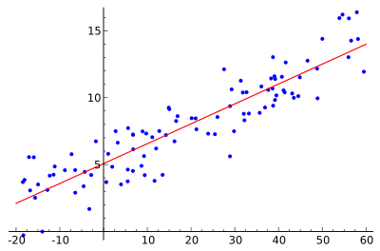
Linear Regression
We want to find the best line (linear function y=f(X)) to explain the data.
y
Rate
Area
X

Slide 28
Linear Regression
Linear regression is one of the most well known and well understood algorithms in statistics and machine learning
Classification-examples-output is categorized
Harmful or not
Tumor size

Slide 29
Linear Regression
simple linear regression- dependent variable depends only on a single independent variable
Multiple Linear Regression

Slide 30
Examples-Regression
Which of the following is a regression task?
Predicting age of a person
Predicting nationality of a person
Predicting whether stock price of a company will increase tomorrow-classification
Predicting whether a document is related to sighting of UFOs?-classification

Slide 31
Examples-Regression
Solution : Predicting age of a person (because it is a real value, predicting nationality is categorical, whether stock price will increase is discrete-yes/no answer, predicting whether a document is related to UFO is again discrete- a yes/no answer). Let’s take an example of linear regression. We have a Housing data set and we want to predict the price of the house. Following is the python code for it.

Slide 32
Linear Regression
Linear Regression is simple to implement.
Less complexity compared to other algorithms.
Linear Regression may lead to over-fitting but it can be avoided using some dimensionality reduction techniques, regularization techniques, and cross-validation.

Slide 33
Linear Regression
As it is very simple- sometime difficult to implement Practical applications

Slide 34
Examples-Classification
Which of the following is/are classification problem(s)?
Predicting the gender of a person by his/her handwriting style-R/C
Predicting house price based on area-R
Predicting whether monsoon will be normal next year-C
Predict the number of copies a music album will be sold next month-R

Slide 35
Examples-Classification
Solution : Predicting the gender of a person Predicting whether monsoon will be normal next year. The other two are regression. As we discussed classification with some examples. Now there is an example of classification in which we are performing classification on the iris dataset using RandomForestClassifier in python. You can download the dataset from

Slide 36
Decision Tree
The decision tree models can be applied to all those data which contains numerical features and categorical features.
Decision trees are good at capturing non-linear interaction between the features and the target variable.
Decision trees somewhat match human-level thinking so it’s very intuitive to understand the data

Slide 37
Decision Tree
Easy to understand and interpret, visually intuitive.
It can work with numerical and categorical features.
Requires little data preprocessing: no need for one-hot encoding, dummy variables

Slide 38
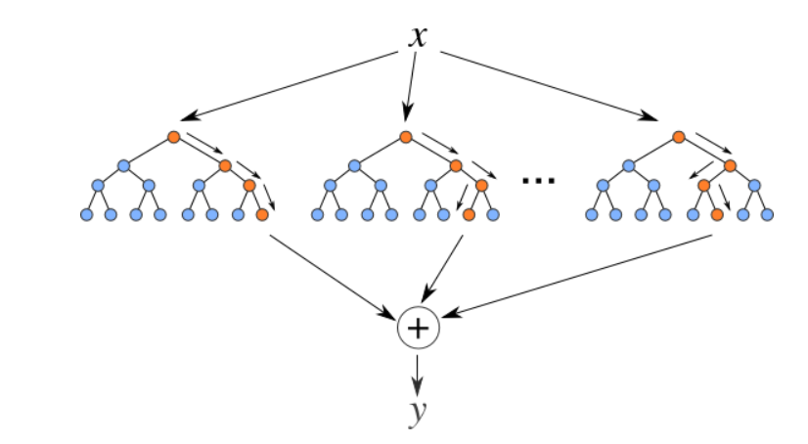
Random Forests
Random Forests are an ensemble(combination) of decision trees. It is a Supervised Learning algorithm used for classification and regression. The input data is passed through multiple decision trees. It executes by constructing a different number of decision trees at training time and outputting the class that is the mode of the classes (for classification) or mean prediction (for regression) of the individual trees.

Slide 39
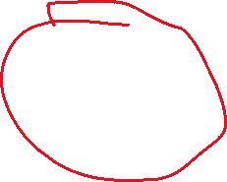








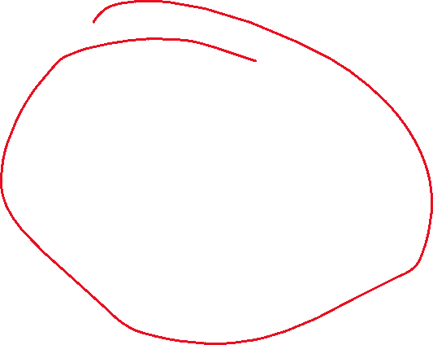

Random Forests

Slide 40
Over-fitting
Overfitting is a modeling error which occurs when a function is too closely fit to a
limited set of data points.
• In reality, the data often studied has some degree of error or random noise within
it. Thus, attempting to make the model conform too closely to slightly inaccurate
data can infect the model with substantial errors and reduce its predictive power.
• In statistics, Overfitting is "the production of an analysis that corresponds too
closely or exactly to a particular set of data, and may therefore fail to fit additional
data or predict future observations reliably".
• An Overfitted Model is a statistical model that contains more parameters than can be justified by the data.
• The essence of overfitting is to have unknowingly extracted some of the residual
variation (i.e. the noise) as if that variation represented underlying model
structure.

Slide 41
Over-fitting
Your model should ideally fit an infinite sample of the type of data you’re interested in.
In reality, you only have a finite set to train on. A good model for this subset is a good model for the infinite set, up to a point.
Beyond that point, the model quality (measured on new data) starts to decrease.
Beyond that point, the model is over-fitting the data.

Slide 42
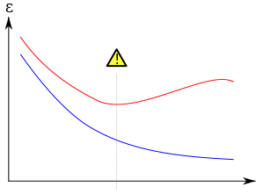
Over-fitting
Over-fitting during training
Model error
Error on new data
Training error
Number of iterations

Slide 43
Over-fitting
Another kind of over-fitting
Model error
Error on new data
Training error
Model degrees of freedom

Slide 44
Regularization and Over-fitting
Adding a regularizer:
Model error
Without regularizer
With regularizer
Number of iterations

Slide 45
Cross-Validation
Cross-validation involves partitioning your data into distinct training and test subsets.
The test set should never be used to train the model.
The test set is then used to evaluate the model after training.

Slide 46
K-fold Cross-Validation
To get more accurate estimates of performance you can do this k times.
Break the data into k equal-sized subsets A_{i}
For each i in 1,…,k do:
Train a model on all the other folds A₁,…, A_{i-1}, A_{i+1},…, A_{k}
Test the model on A_{i}
Compute the average performance of the k runs

Slide 47
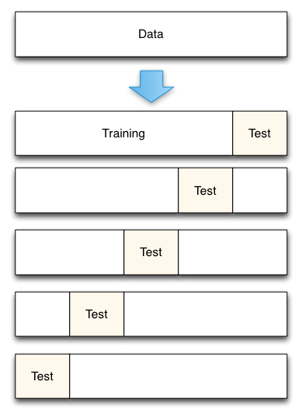
5-fold Cross-Validation

